Slide 1

in cooperation with SHREWS Ltd.
presents
the next generation of green energy
responsible / profitable / practical
A presentation by
Ed Kalvins, President & CEO, TPI
August, 2015
Technical Partners International Inc. CANADA • LATVIA • SAUDI ARABIA • TURKEY • UKRAINE • UNITED KINGDOM

Slide 2
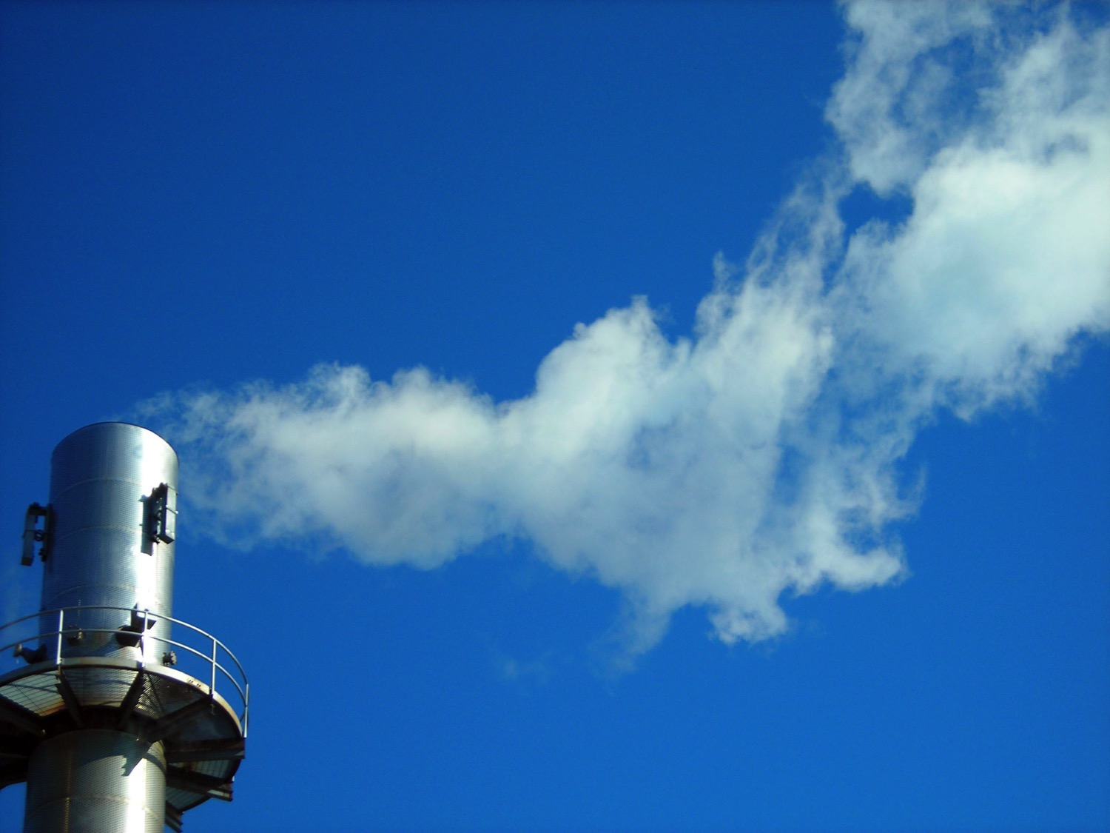

Cogeneration
Energy from waste or biomass
using
Advanced Thermal Treatment (ATT) technology
from
of the US
Technical Partners International Inc. CANADA • LATVIA • SAUDI ARABIA • TURKEY • UKRAINE • UNITED KINGDOM

Slide 3
For the production of
steam to generate electricity for use or sale
steam for industrial process steam
lower waste disposal costs
gas for I/C Engine/gen-sets
gas for co-firing of utility boilers
direct firing of thermal oxidizers
heat for the direct firing of dry kilns
Technical Partners International Inc. CANADA • LATVIA • SAUDI ARABIA • TURKEY • UKRAINE • UNITED KINGDOM

Slide 4
Fuel - Types of Fuels Handled
18 Biomass fuel materials
10 Waste stream materials
3 Fossil fuel materials
Technical Partners International Inc. CANADA • LATVIA • SAUDI ARABIA • TURKEY • UKRAINE • UNITED KINGDOM

Slide 5
Fuel - Types of Fuels Handled
wood and wood waste
agricultural residues
paper mill sludge
waste water treatment sludge
processed municipal solid waste (RDF)
Technical Partners International Inc. CANADA • LATVIA • SAUDI ARABIA • TURKEY • UKRAINE • UNITED KINGDOM

Slide 6
Fuel - Commercially Proven
Refuse Derived Fuel
Wood Chips
Bio solids (Waste water treatment)
Saw Dust
Wood Flour
Coal
Rice Hulls
Rice Straw
Oat Hulls
Carpet Wastes
Tannery Residue
Olive Waste (Sanza)
Wine (distillery) Residue
Technical Partners International Inc. CANADA • LATVIA • SAUDI ARABIA • TURKEY • UKRAINE • UNITED KINGDOM

Slide 7
Fuel - Successfully Tested
Tire Derived Fuel
Sander Dust
Switch grass
Urban Green Waste
Masonite™ Dust
Whole Tree Waste
Sugar Cane Bagasse
Furfural Residue
Chicken Litter – Rice Hull Bedding
Chicken Litter – Wood Bedding
Turkey Litter
Pine Tree Bark
DDGS
Technical Partners International Inc. CANADA • LATVIA • SAUDI ARABIA • TURKEY • UKRAINE • UNITED KINGDOM

Slide 8
Waste Feed Stock
C - 40.3%
H - 4.7
N - 0.08
O - 31.1
Ash - 3.8
H2O - 20.0
LHV - 14.5MJ/kg @ 20% moisture
Technical Partners International Inc. CANADA • LATVIA • SAUDI ARABIA • TURKEY • UKRAINE • UNITED KINGDOM

Slide 9
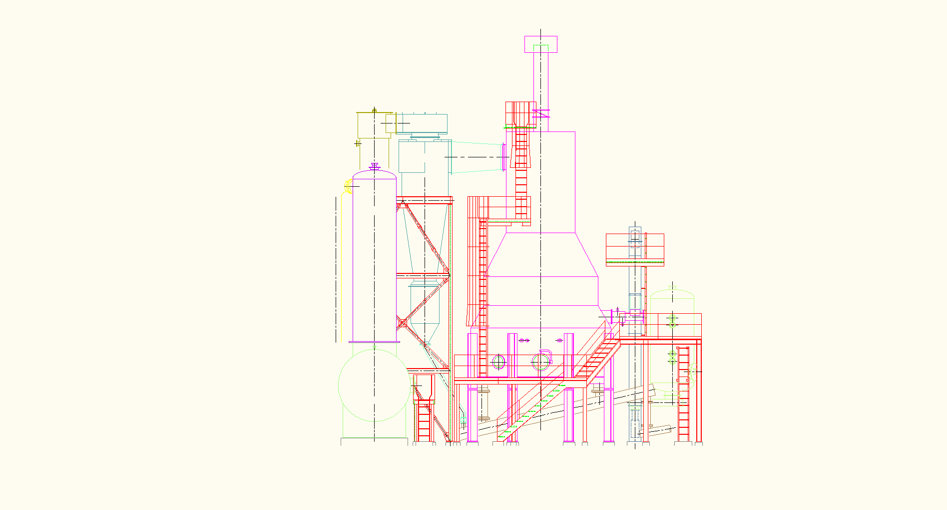
The Gasification System
The PRM Energy KC-Reactor® gasification system is a sub-stoichiometric, updraft system with:
Metered and measured feeding system.
Water cooled components.
Fixed grate, updraft.
Precisely controlled gasification air to achieve desired syngas quality.
Adjustable depth, agitated bed to control residence time and carbon conversion.
Continuous ash discharge.
Optional high temperature cyclone.
Optional staged combustion systems.
Optional syngas conditioning system.
Technical Partners International Inc. CANADA • LATVIA • SAUDI ARABIA • TURKEY • UKRAINE • UNITED KINGDOM

Slide 10
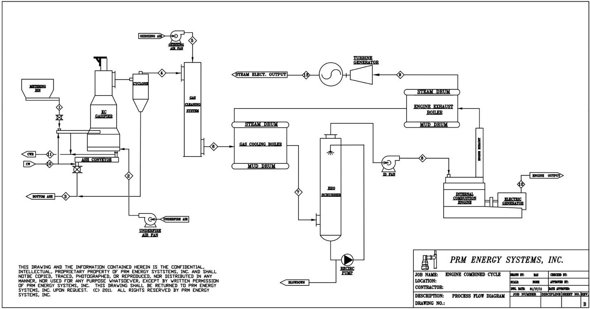
Process Flow
Steam/Power Generation
Technical Partners International Inc. CANADA • LATVIA • SAUDI ARABIA • TURKEY • UKRAINE • UNITED KINGDOM

Slide 11
Process Flow
Engine Generation
Technical Partners International Inc. CANADA • LATVIA • SAUDI ARABIA • TURKEY • UKRAINE • UNITED KINGDOM

Slide 12
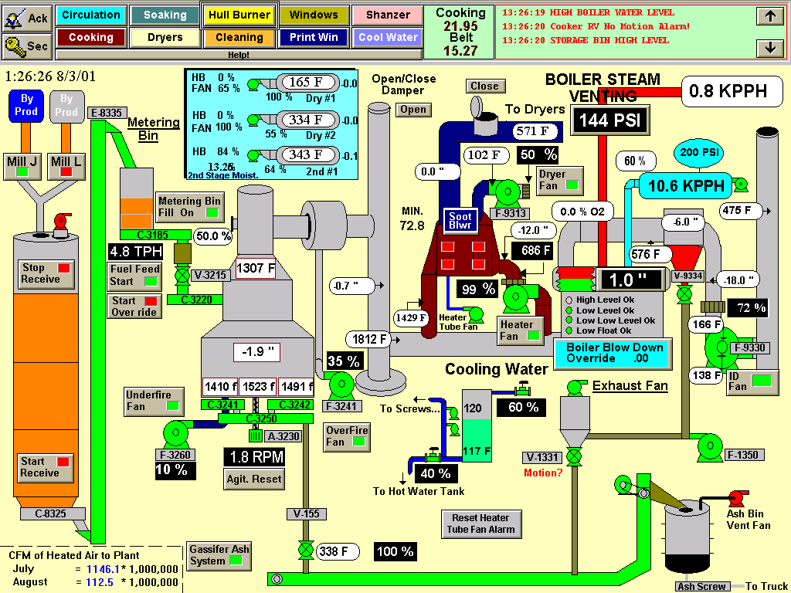

Process Steam & Drying
Gasifier
Technical Partners International Inc. CANADA • LATVIA • SAUDI ARABIA • TURKEY • UKRAINE • UNITED KINGDOM

Slide 13
Standards
Built to meet EU and local Environmental standards.
Technical Partners International Inc. CANADA • LATVIA • SAUDI ARABIA • TURKEY • UKRAINE • UNITED KINGDOM

Slide 14
Model Capacities
Projects can be scaled to meet customer requirements:
Model | Biomass Input MT/hr at 6000 Btu/lb (3333 kcal/kg) | Range of Gross Potential Power Generation (kWe)
KC-8® | 1.00 | 861.6 | ─ | 1,077.0
KC-10® | 1.56 | 1,346.2 | ─ | 1,682.7
KC-12® | 2.25 | 1,938.5 | ─ | 2,423.2
KC-14® | 3.06 | 2,638.6 | ─ | 3,298.2
KC-16® | 4.00 | 3,446.3 | ─ | 4,307.8
KC-18® | 5.06 | 4,361.7 | ─ | 5,452.1
KC-20® | 6.25 | 5,384.8 | ─ | 6,731.0
KC-22® | 7.56 | 6,515.6 | ─ | 8,144.5
KC-24® | 9.00 | 7,754.1 | ─ | 9,692.6
Technical Partners International Inc. CANADA • LATVIA • SAUDI ARABIA • TURKEY • UKRAINE • UNITED KINGDOM

Slide 15
Delivery Times
Estimated Delivery: 12 – 18 months
Estimated erection time: Approximately 4 – 6 months after delivery
Technical Partners International Inc. CANADA • LATVIA • SAUDI ARABIA • TURKEY • UKRAINE • UNITED KINGDOM

Slide 16
The Company
32 years of designing, building and operating gasifiers
PRM Energy Systems, Inc., Arkansas, U.S.A
incorporated in 1973
Technology developed and patented by Mr. Ron Bailey, Sr.
The first two gasifiers installed in 1982
During the period 1984-88, many types of biomass fuels were tested including i.e.: rice hulls, rice straw, chicken litter, green bark, sawdust and chips, peat, wheat straw, corn cobs and stubble, peanut hulls, RDF (fluff, flake and pellet), petroleum coke, cotton gin waste, cotton seed hulls and low grade coal. All successfully converted to clean syngas.
PRME’s gasification technology since
  1982 in the United States,
  1985 in Australia,
  1987 in Malaysia and
  1995 in Costa Rica.
Technical Partners International Inc. CANADA • LATVIA • SAUDI ARABIA • TURKEY • UKRAINE • UNITED KINGDOM

Slide 17

Technical Partners International Inc. CANADA • LATVIA • SAUDI ARABIA • TURKEY • UKRAINE • UNITED KINGDOM

Slide 18
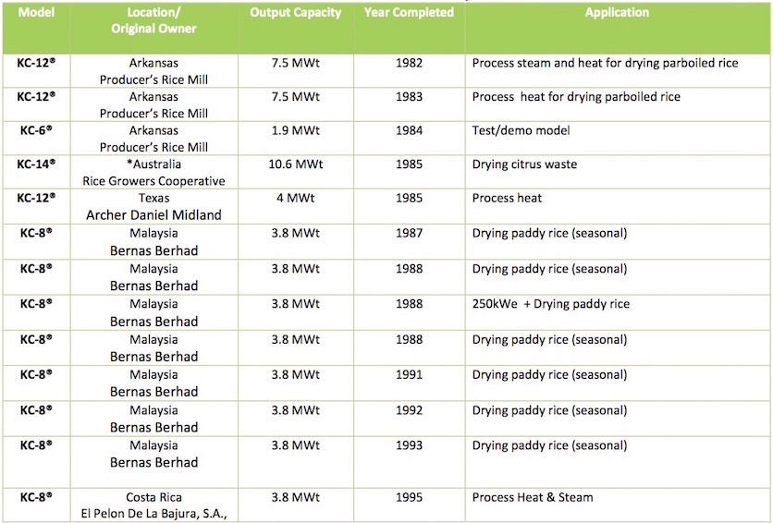
Installed Gasification Systems
Technical Partners International Inc. CANADA • LATVIA • SAUDI ARABIA • TURKEY • UKRAINE • UNITED KINGDOM

Slide 19
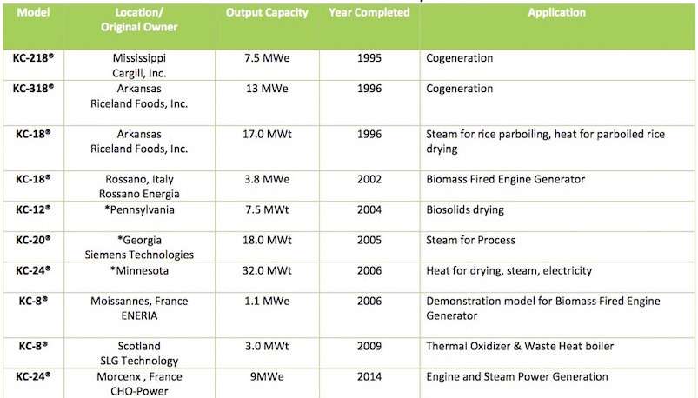
Installed Gasification Systems
Technical Partners International Inc. CANADA • LATVIA • SAUDI ARABIA • TURKEY • UKRAINE • UNITED KINGDOM

Slide 20
PRM Energy
Plants in
Operation
Technical Partners International Inc. CANADA • LATVIA • SAUDI ARABIA • TURKEY • UKRAINE • UNITED KINGDOM

Slide 21
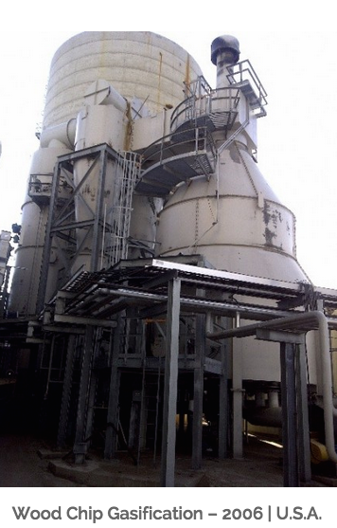
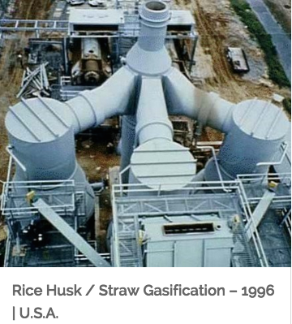
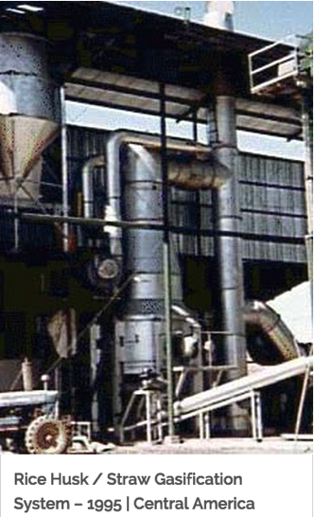
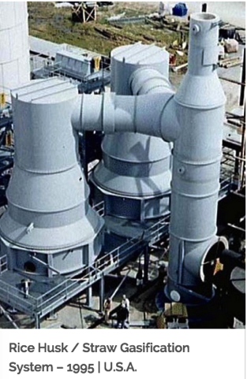
PRME Cogeneration (CHP) Plants
Technical Partners International Inc. CANADA • LATVIA • SAUDI ARABIA • TURKEY • UKRAINE • UNITED KINGDOM

Slide 22
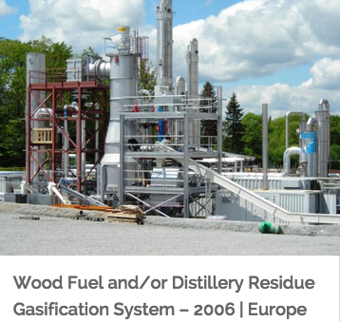
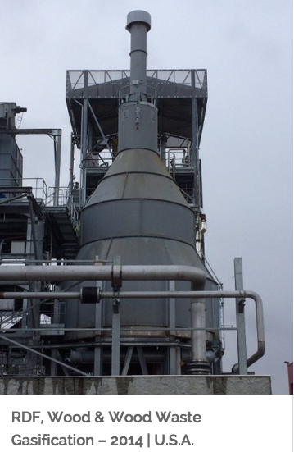
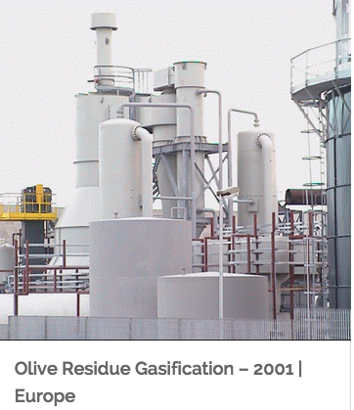
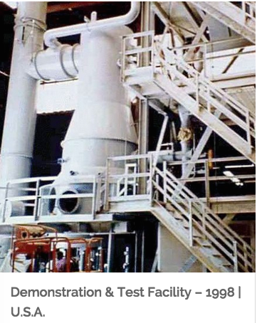
PRME Electrical Generation
Technical Partners International Inc. CANADA • LATVIA • SAUDI ARABIA • TURKEY • UKRAINE • UNITED KINGDOM

Slide 23
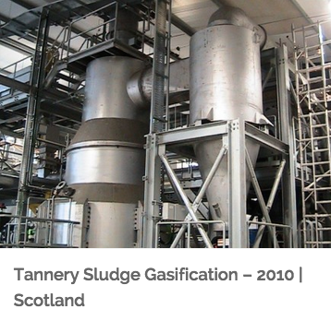
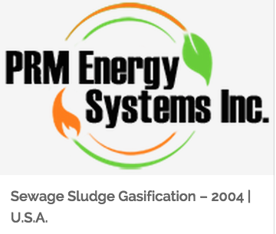
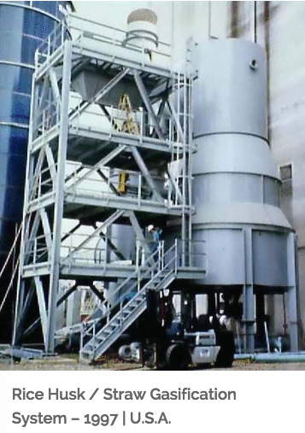
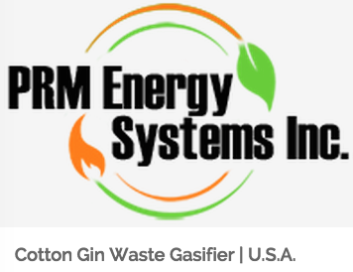
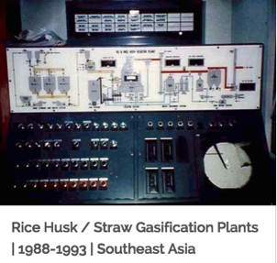
PRME Thermal Applications
Technical Partners International Inc. CANADA • LATVIA • SAUDI ARABIA • TURKEY • UKRAINE • UNITED KINGDOM

Slide 24
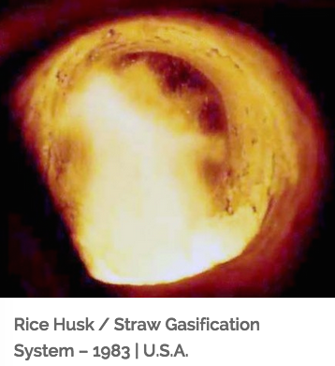
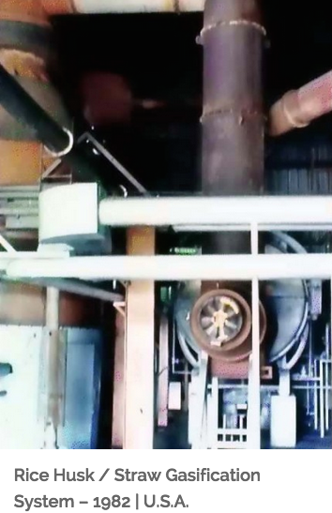
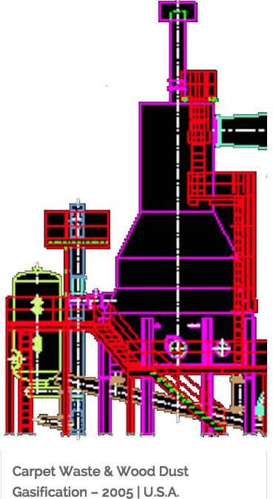
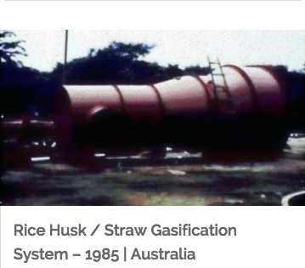
PRME Thermal Applications
Technical Partners International Inc. CANADA • LATVIA • SAUDI ARABIA • TURKEY • UKRAINE • UNITED KINGDOM

Slide 25
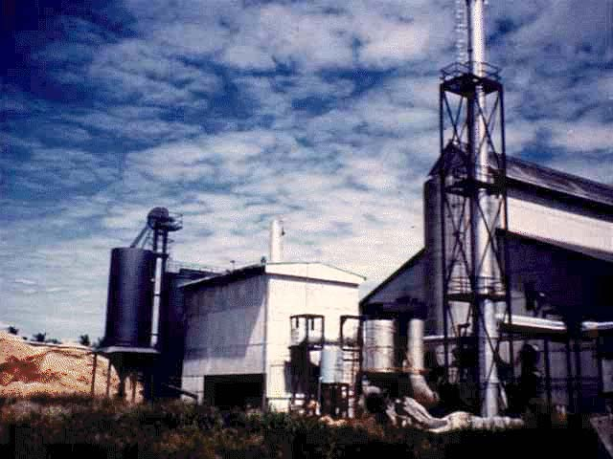
Malaysia (1 of 7 plants)
Technical Partners International Inc. CANADA • LATVIA • SAUDI ARABIA • TURKEY • UKRAINE • UNITED KINGDOM

Slide 26
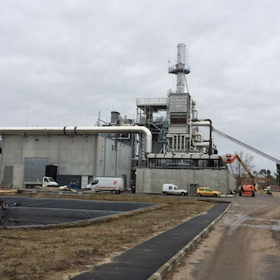
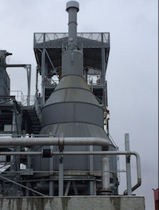
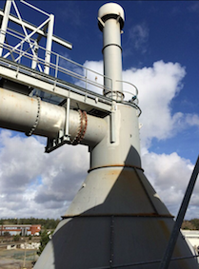
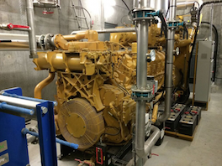
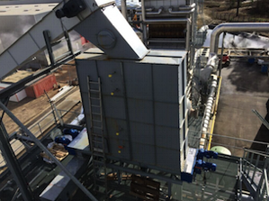
France - 2014
PRME commissioned its latest Waste to Energy Gasification System in late, 2014. The 200 tons/day PRME Gasifier produces a combustible syngas from RDF and other waste fuels and conditioned for firing a Combined Cycle Internal Combustion Engine/Generator System and a steam turbine system. The syngas from the PRME gasifier will fire six (6) Caterpillar G3516 IC Gensets to generate 6.0 MWe gross with another 2.0MWe from the Combined Cycle and the world’s most respected IC engine/generator.
Technical Partners International Inc. CANADA • LATVIA • SAUDI ARABIA • TURKEY • UKRAINE • UNITED KINGDOM

Slide 27
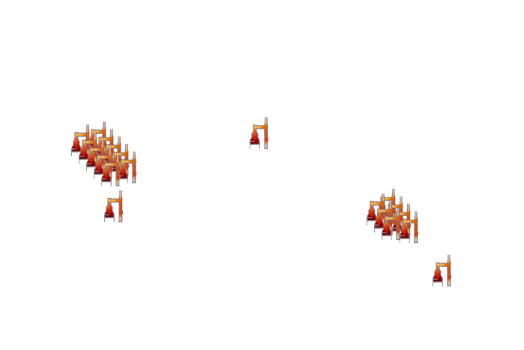



FOR OVER 30 YEARS
PLANTS OPERATING ON FIVE CONTINENTS
Technical Partners International Inc. CANADA • LATVIA • SAUDI ARABIA • TURKEY • UKRAINE • UNITED KINGDOM

Slide 28
Letters of Recommendation
Letters of recommendation are available on request from satisfied customers, including:
Riceland Foods, Inc. – the largest rice processor in the world. Riceland has two PRME systems at Stuttgart and Jonesboro. These two plants were both commissioned in December, 1996 and convert 685 tons per day of biomass to heat, steam and electricity.
ENERIA, Moissannes (France)— ENERIA is the Caterpillar distributor for France, Poland, Romania, Algeria and Belgium. ENERIA purchased a test/demo PRME system in 2005 to confirm that the PRME Gasifier would produce a suitable syngas for firing the Caterpillar Internal Combustion Engine. ENERIA operated the plant for approximately 6 years to test the PRME system on various types of biomass fuels and processed municipal solid waste.
PHILIPPE DAVERAT, retired Managing Director of ENERIA. Mr. Daverat was instrumental in the establishment of the PRME test/demo system in Moissannes and the monitoring of the tests and results of the PRME Gasification System operating on various waste fuels including MSW and RDF. After his retirement from ENERIA, Mr. Daverat was employed as a consultant by CHO Power to consult on the CHO gasification plant at Morcenx, France.
Technical Partners International Inc. CANADA • LATVIA • SAUDI ARABIA • TURKEY • UKRAINE • UNITED KINGDOM

Slide 29
Insurance
Protecting the Investor
Insurance may be available on request.
Technical Partners International Inc. CANADA • LATVIA • SAUDI ARABIA • TURKEY • UKRAINE • UNITED KINGDOM

Slide 30
Written Descriptions / Papers
(available on request)
BioSolids Disposal
Clean Heat, Steam and Electricity from Rice Hull Gasification
PRME Recovery Systems
Original PRME Gasifiers Installed 1982-83, Producers Rice Mill Inc. Stuttgart, Arkansas
Refuse Derived Fuel (RDF) Gasification Test Report
A Case Study of Two Biomass Gasification Systems Converting 650 Tons/Day of Rice Hulls to PRME NaturallygasTM
Sludges
Technical Partners International Inc. CANADA • LATVIA • SAUDI ARABIA • TURKEY • UKRAINE • UNITED KINGDOM

Slide 31

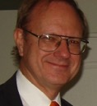




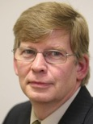


Technical Partners International Inc.
Key Personnel
Ed Kalvins, P. Eng
President & CEO
Rai Martinsons
Project Coordinator
Canada
Andris Pumpurs
Environmental Specialist
Latvia
John Birchmore
Managing Director, SHREWS Ltd
Renewable Energy Specialist
Alvis Līdums
Project Manager
Latvia
Inguna Gustava
Business Development
Latvia
Anita Boldāne
Project Coordinator
Latvia
Indra Sproģe-Kalviņa
Administration
Latvia
Arnis Markitants
Business Development
Canada
PLUS: over 70 specialists and personnel from Canada, Latvia and the UK
providing consulting, project management and technical solutions for cogeneration using Advanced Thermal Treatment technology
Technical Partners International Inc. CANADA • LATVIA • SAUDI ARABIA • TURKEY • UKRAINE • UNITED KINGDOM

Slide 32
Technical Partners Contribution
Technical Partners has access to the necessary expertise to put a project together through from inception, planning, financing and project implementation.
We help by completing the following:
Scoping Study that identifies the client’s conditions and associated costs
User Requirement Specification (URS) that provides the information needed by the equipment supplier to provide a good budget quote
For more information, see
http://tpriga.lv/energy-from-waste--biomass-cogeneration
We then help with project management by using the PM-PROformance™ project management system (http://pm-proformance.com/) to get the job done properly.
Technical Partners International Inc. CANADA • LATVIA • SAUDI ARABIA • TURKEY • UKRAINE • UNITED KINGDOM

Slide 33
Contact Information
Ed Kalvins
SIA “TP Riga”
Technical Partners International Inc.,
ed.kalvins@tpriga.lv
+371-29-255-223
SKYPE: ed.kalvins
We don’t just offer cogeneration …
We offer solutions
Technical Partners International Inc. CANADA • LATVIA • SAUDI ARABIA • TURKEY • UKRAINE • UNITED KINGDOM

Slide 34
Thank you for your attention!
Please visit us at
www.prmenergy.com
www.tpriga.lv
www.technicalpartners.ca
www.pm-proformance.com
www.shrews.co.uk
Technical Partners International Inc. CANADA • LATVIA • SAUDI ARABIA • TURKEY • UKRAINE • UNITED KINGDOM

Slide 35
Frequently Asked Questions
Technical Partners International Inc. CANADA • LATVIA • SAUDI ARABIA • TURKEY • UKRAINE • UNITED KINGDOM

Slide 36
Unique selling points
What’s PRME’s Unique Selling Points?
Early patents have expired; however, additional patents and proprietary technology have been added over the years, pertaining mainly with residence time of the fuel and the syngas, gasification air control, control system, syngas conditioning, etc.
PRM Energy has not only 33 years of experience in the gasification business, but have gasified more biomass than all other gasification technologies combined.
There are PRME systems operating today that have operated in high demand industrial applications for over 33 years. No other gasification technology can match PRME’s track record.
There are many “gasification technology” companies out there in cyber-land making big claims with “USP”. All you have to do is ask them, “Can we see one of your plants”. Usually that will end the conversation because they don’t have a plant. In PRME’s case, the question is more like “which plant do you want to see”. This will be based more on the type of materials the client wishes to process.
Technical Partners International Inc. CANADA • LATVIA • SAUDI ARABIA • TURKEY • UKRAINE • UNITED KINGDOM

Slide 37
PRME Systems
1. PRME Waste Gasification Fired IC Engine/Generator System
2. PRME Waste Gasification Steam Cycle Systems
Which system is more efficient?
System number 1 is more efficient .With same fuel, number 1, in simple cycle, will generate approximately 17% more electricity than no. 2..
Which system is suitable for co-generation
Both systems can generate steam and electricity.
Which system has less opex?
Depending upon the fuel composition, opex is lower on no. 1.
Environmental Impact: Does PRME meet local disposal & environmental standards?
PRME has installed it’s systems on five continents and all of the installations meet required emissions regulations.
System Stability
The PRME Gasification System makes automatic adjustments of operating parameters to maintain a high state of stability.
Technical Partners International Inc. CANADA • LATVIA • SAUDI ARABIA • TURKEY • UKRAINE • UNITED KINGDOM

Slide 38
PRME Systems
Apart from gas, what is generated by the syngas conditioning system?
The Gas Conditioning System is a gas cleaning application where tars and hydrocarbons are eliminated from the syngas prior to cooling of the syngas. This application is for IC Engine Systems – not for Steam Cycle Systems.
Do the estimated net electrical outputs for these systems take into consideration the power requirements of the MRF?
The estimated net electrical generation does NOT include consideration of the power requirement for the MRF.
If not, normally how much estimated power is required by MRF? Can MRF use the power/heat generated by PRME system itself?
The estimated power requirement for the MRF is about 500kWe/hour, depending upon the through-put and composition of the MSW.
How long is the lifetime of PRME system?
PRME has systems that have been in around the clock operation in high demand industrial applications for over 33 years.
Technical Partners International Inc. CANADA • LATVIA • SAUDI ARABIA • TURKEY • UKRAINE • UNITED KINGDOM

Slide 39
PRME Systems
The syngas is induced from the gasifier through a proprietary mechanisms that cool and condition the gas… the initial cooling is accomplished by indirect heat exchange with air or water’
How much water is required per day or per year by a KC-24 system?
How much water per day or per year is required by a KC-24 IC engine system?
The water used for cooling the syngas is recirculated. When water is used for the syngas, it is through a heat recovery steam generator, which produces steam that can be used either in a steam turbine to produce additional electricity, for indirect drying systems or other CHP systems.
PRME IC engine system startup time. How long does it take from PRME gasifier is started up until IC engine start work. Please describe briefly the procedure.
PRME provides a “pre-heater” that is inserted into the gasifier to bring the gasifier temperature up to operating temperature (approximately 750C). This take approximately 6 to 8 hours. Once the gasifier temperature reaches operating temperature, the pre-heat burner is removed and the feed stock is started. If it is an engine system, the syngas will be “flared” and tested until it is suitable for operating the IC Engine. A suitable syngas will be produced in minutes and the IC engines will be started. If it is a steam cycle system, the syngas will be combusted on the way to the boiler.
Depending upon the analysis of the RDF being gasified, the ash is a “bio-char” that can be used as a soil enrichment, soil amendment and other land applications. Again, depending upon the analysis of the RDF, the ash can possibly be used in asphalt for road building and repairs. We have been selling ash produced from rice husk to steel mills in the US, Europe, Japan and South Africa to be used as an insulating topping for ladles and tundages. We have sold over ¼ million tons at a price of US$100.00 per ton bulk fob the gasification plant.
Technical Partners International Inc. CANADA • LATVIA • SAUDI ARABIA • TURKEY • UKRAINE • UNITED KINGDOM

Slide 40
Cooperation
Would PRME a JV with one or more local parties?
No.
PRME sells equipment, provides erection advisory services, star-up assistance and commissioning and training of operators
PRME may License the fabrication the PRME systems, provide drawings for fabrication, assist with erection advisory services, provide proprietary patented equipment
We do not travel at our expense to attend “question and answer” meetings. We will be happy to participate in a “question and answer” telephone or skype conference call at most any time.
Technical Partners International Inc. CANADA • LATVIA • SAUDI ARABIA • TURKEY • UKRAINE • UNITED KINGDOM

Slide 41
Inputs and Outputs
What are the inputs and outputs?
The input is the waste fuel.
The output is steam, heat and electricity.
The Gasification Process does not create dioxins. If dioxins are contained in the fuel being gasified, the temperature attained in the gasification/gas combustion process destroys the dioxins.
If heavy metals are present in the feed, the heavy metals will most likely not be volatilized and will remain in the ash. If some heavy metals are found in the syngas, lime injection and/or activated carbon filtration/absorption can remove them.
How much electric/heating are generated?
A typical RDF fuel will generate approximately 725 kWe per metric ton gross output.
The amount of electricity and heat generated are a direct result of the chemical analysis of the waste fuel.
Technical Partners International Inc. CANADA • LATVIA • SAUDI ARABIA • TURKEY • UKRAINE • UNITED KINGDOM

Slide 42
Waste
What are the requirements of waste?
for PRME Waste Gasification Fired IC Engine/Generator Systems
The combustible syngas produced from the waste is conditioned and cooled for firing IC Engines.
the waste feed stock to be gasified must
contain a minimum calorific value of 15.3MJ/kg at
a maximum moisture content of 20% and
maximum particle size of 10mm
for PRME Waste Gasification Steam Cycle Systems
The combustible syngas produced from the waste is fully combusted and fired directly into a Heat Recovery Steam Generator (HRSG) to raise steam for a steam turbine/generator or for process steam. The waste feed stock must
contain a minimum calorific value of 12.0MJ/kg at
a maximum moisture content of 30% and
maximum particle size of 10mm
Technical Partners International Inc. CANADA • LATVIA • SAUDI ARABIA • TURKEY • UKRAINE • UNITED KINGDOM

Slide 43
Waste
How much waste can be treated per annum?
The PRME Gasification System is modular and can handle an unlimited amount of waste.
Could PRME gasifier be able to treat following:
Industrial sludge
We have a PRME plant gasifying dried industrial sludge. The sludge comes into the plant at approximately 20% solids. It is dried to approximately 80% solids and gasified to provide heat and steam to a process.
Industrial waste
Depends upon the composition of the industrial waste.
Clinical waste
Depends upon the composition of the clinical waste.
Can gasifiable waste can be completely gasified by PRME system?
Gasification (conversion efficiency) will range from roughly 60% to 95%, depending upon the actual chemical analysis of the fuel, whether the application is a steam cycle or IC Engine cycle and the operating parameters of the gasifier (temperature, retention time, addition of O²/steam, ash fusion temperature etc. Generally, the ash will contain some unconverted carbon. If the client desires, we can add an ash carbon gasifier to further process the ash.
Technical Partners International Inc. CANADA • LATVIA • SAUDI ARABIA • TURKEY • UKRAINE • UNITED KINGDOM

Slide 44
End Products
Apart from electricity and heat, syngas, what other end products are generated, in particular, are there any solids, fly ash, slag? Particular how much fly ash is generated.
Ash and flyash are produced - the amount depends upon how much ash is in the waste fuel.
How the end products are treated? E.g. fly ash
Ash and flyash are “conditioned” ie: cooled with a water quench.
If Ash is “conditioned” ie: cooled with a water quench, then what kind of product is produced after cooled with a water quench?
The ash is very small particle size and light weight. Mixed with asphalt, it would be good for roads.
What is ash fusion temperature
The ash fusion temperature for the RDF should be minimum 1200C. The ash fusion temperature is a very common specification and is determined by a lab that is licensed or authorized to perform analysis on fuels and by products. The area most likely to reach 1200C during the gasification process is on the grate at the bottom of the gasifier. The gasifier is programmed to operate below the ash fusion temperature to prevent ash fusion.
Technical Partners International Inc. CANADA • LATVIA • SAUDI ARABIA • TURKEY • UKRAINE • UNITED KINGDOM

Slide 45
End Products
Solid (i.e flyash) and waste water (from liquid scrubber) are also generated. How are the solid and waste water treated?
The flyash is blended back with the gasifier bottom ash. There is no presently no liquid scrubber employed.
How is the ash treated after being moved into the ash storage bin? Where does the ash go? Does it goes to landfill or bin?
The ash has been conditioned prior to moving to the ash storage bin. The ash can go to “land application” or landfill depending upon the analysis of the ash. It may qualify for addition to asphalt or road application.
Before ash goes to landfill, is the ash classified as ‘normal waste’ or ‘hazardous waste’?
Usually Normal Waste, depending on what was in the feedstock initially.
Is there any by-product need go to landfill or potentially cause second pollution?
All of the non-combustible material in the raw MSW will need to go to the landfill.
Emission control: How the emission air is treated?
Emissions are controlled with readily available emissions control equipment.
Normally how much cost will take to treat the end products and emission air?
The type of equipment and cost depends upon the contaminants contained in the waste fuel.
Technical Partners International Inc. CANADA • LATVIA • SAUDI ARABIA • TURKEY • UKRAINE • UNITED KINGDOM

Slide 46
Capex
The Capital Cost of a plant depends upon the type and size of the plant and the type of waste fuel to be gasified.
How much would plant cost?
650 tons per day of raw MSW converted to
380 tons per day of RDF
containing a minimum LCV of 14.5MJ/kg
@ maximum 20% moisture and
maximum 10mm particle size
generates about 10 MWe
budget priced @US$35.0 million Ex Works.
budget priced at US$3,500 per kW Ex Works,
90 tons per day of RDF feedstock
generates about 2.5 MWe
budget priced @US$12.6 million Ex Works.
including the Materials Recovery Facility to process the raw MSW to RDF.
This budget price is for the equipment only, not including any civil works, buildings etc.
180 tons per day of RDF feedstock
containing a LCV of 14.0 MJ/kg
@ 15 per cent moisture and
maximum 10mm particle size
generates about 4.8 MWe
generates about 12 - 13 GJ/hr = 3.6 MWth
budget priced at US$18.2 million Ex Works.
Technical Partners International Inc. CANADA • LATVIA • SAUDI ARABIA • TURKEY • UKRAINE • UNITED KINGDOM

Slide 47
Opex
What is the cost to generate 1KW/h of electricity?
A 10MWe system is estimated to cost 3 – 4 US cents/kWe.
The cost to generate 1kW/h of electricity is a direct function of the size and type of the plant and the fuel to be gasified.
How much is the Opex of a typical plant? What are the main costs of Opex?
Typical Opex for a 10MWe plant is estimated at 2 – 3 percent of CAPEX.
Labor in the MRF is the main expense.
Fuel oil
Does PRME require oil during operating? If yes, how much litres of oil are required per hour?
No.
Technical Partners International Inc. CANADA • LATVIA • SAUDI ARABIA • TURKEY • UKRAINE • UNITED KINGDOM

Slide 48
Equipment
What equipment / devices are required for initial plants?
  The PRME Gasifier System,
  HRSG,
  T/G,
  Dust Collector,
  Cooling Tower,
  Fuel Receiving and Processing Facility (MRF).
Normally, how long would it take to complete one plant project? And what are the different stages involved?
Equipment shipment in 14 – 16 months.
Approximately 6 – 8 months for installation, start-up and commissioning.
Technical Partners International Inc. CANADA • LATVIA • SAUDI ARABIA • TURKEY • UKRAINE • UNITED KINGDOM

Slide 49
Vital statistics
What is the plant height
The height of the plant is different for each size.
The highest point for a PRME Model KC-224 is approximately 65ft.
What is the plant footprint for a 10 MWe plant
The area required is estimated at 50m X 75m.
Technical Partners International Inc. CANADA • LATVIA • SAUDI ARABIA • TURKEY • UKRAINE • UNITED KINGDOM

Slide 50
The latest French plant
The PRME Gasifier in France (2014) is essentially the same technology as the PRME Gasifier in Arkansas (1982).
The French Gasifier is larger and is making a “syngas” that is used for firing IC Engines.
The Arkansas Gasifier is direct firing a steam boiler.
How long did it take to build this plant?
Two years.
How long has the plant been operating/running?
One year
What type of waste is treated? i.e. msw
MSW RDF SRF
How much waste and RDF are treated?
200 tons per day
What model of PRME gasifier are used?
PRME Model KC-24
Technical Partners International Inc. CANADA • LATVIA • SAUDI ARABIA • TURKEY • UKRAINE • UNITED KINGDOM

Slide 51
The latest French plant
How is the ash been treated?
The ash is not treated. It is being directed to a “skip” bin and to reduce the dust, a water spray is applied to the “skip”
What is an ‘ash carbon gasifier’
Generally, the ash will contain some unconverted carbon. If the client desires, an ash carbon gasifier can be added to further process the ash.
It will be a KC-8 gasifier.
How much ash go to landfill per day or per month of French plant?
The ash content in the fuel in France varies between 15 to 25%. The ash discharge from the system is between 28 and 48 tonnes per day.
Where does the ash go after leaving plant?
Landfill, depending upon the ash analysis, it may be used for land applications.
How the wastewater is treated?
There is no waste water.
How the odor is treated?
There is no odor. Normally, the MRF building will be under negative pressure.
Technical Partners International Inc. CANADA • LATVIA • SAUDI ARABIA • TURKEY • UKRAINE • UNITED KINGDOM

Slide 52
The latest French plant
Please provide an emission report to show the plant emission meet EU standard.
We do not have an emissions report. The plant is permitted and operates within the EU regulations.
Was additional air emission control or treatment systems added to the French plant apart from PRME standard gas condition system?
The French plant has “lime injection” for control of SO2 and HCl.
What man-power is required by the plant?
MRFs can contain varying amounts of automation. Depending upon the Client’s desire/ requirement for automation, the MRF will employ 5 – 15 per shift.
Technical Partners International Inc. CANADA • LATVIA • SAUDI ARABIA • TURKEY • UKRAINE • UNITED KINGDOM

Slide 53
The latest French plant
How often is regular or major maintenance work required for the PRME gasifier system of the French plant?
The PRME Gasifier requires a very minimum amount of small or big maintenance work. We recommend that the gasifier be scheduled for 2 weeks down time for maintenance per year.
There is no part that will be replaced regularly.
There will be a recommended spare parts inventory.
Estimated repairs are 1 – 2% of the Capital costs.
How often will maintenance work take place?
The MRF will operate approximately 20 hours per day 5 or 6 days per week. Regular Maintenance will be scheduled during the 4 hours of downtime each day. Major maintenance will be scheduled on week-ends.
What major part will be replaced regularly?
There is no part that will be replaced regularly. There will be a recommended spare parts inventory.
How much are replacement costs?
Estimated repairs are 1 – 2% of the Capital costs.
Technical Partners International Inc. CANADA • LATVIA • SAUDI ARABIA • TURKEY • UKRAINE • UNITED KINGDOM

Slide 54
Other questions
Can Syngas be piped into a network
The syngas produced cannot be “piped” into a network to supply families with “cooking gas”.
The syngas is low calorific and will condense in the piping.
It may be possible to pipe the syngas 200 feet maximum in a heated pipe.
Can syngas be stored in tanks like LNG
The syngas cannot be stored in tanks like LNG. It has to be used immediately.
Technical Partners International Inc. CANADA • LATVIA • SAUDI ARABIA • TURKEY • UKRAINE • UNITED KINGDOM

